Slide 1
Lesson Objective
Need whiteboards
Title: Orthogonal views
Aim
Describe and draw orthogonal views of 3D shapes.
Plan
Review negative numbers
Notes
Blocks Practice
Exit Ticket

Slide 2
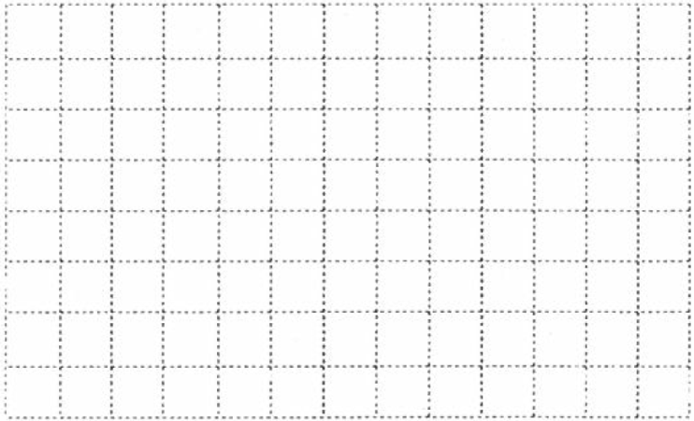
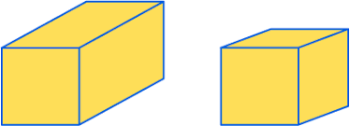
Oblique projections of shapes
The FRONT is FLAT
Draw the front of the shape
Draw lines ‘going backwards’ at the same angle
Fill in the rest of the shape
What are the names of these shapes?
Try drawing both on your whiteboard

Slide 3

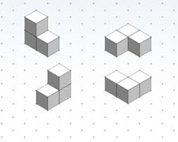
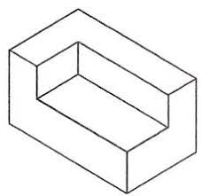
Isometric projections of shapes
Have paper Landscape
View ALL sides DIAGONALLY
Lines only go vertically or diagonally
Draw one face of the shape
Draw lines for the back of the shape
Fill in the rest of the shape
Shade faces that point the same direction

Slide 4
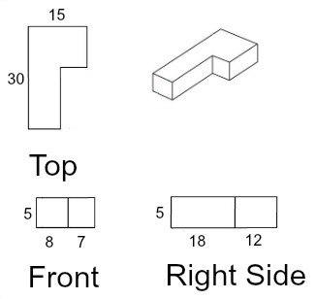
Orthographic view example

Slide 5
Orthogonal view
Orthographic drawings are a type of drawing where you only draw what you can see
Orthographic drawings are also known as Multiview drawings
The most commonly used views are top, front, and right side.

Slide 6
Orthogonal Drawings of shapes
Draw the Front, Right and Top views
Make sure they are scaled and oriented the same – look for the arrow
Draw the Front first
Draw the Top above
Draw the Right to the right
Top
Front
Right
Use cubes if you need to, but you should aim to do at least one without them

Slide 7
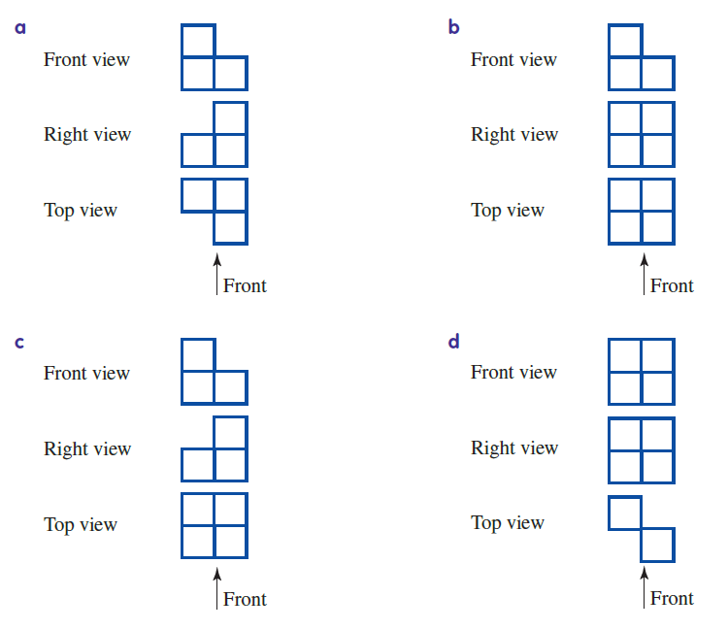
Orthogonal Drawings of Shapes

Slide 8
Rule up your page
Title: Drawing Orthographic shapes
Shape | Top view | Front view | Right Side view

Slide 9
Blocks practice
Using one single block draw the front, top and right view.
Stack two blocks on top of each other and draw the front, top and right view.

Slide 10
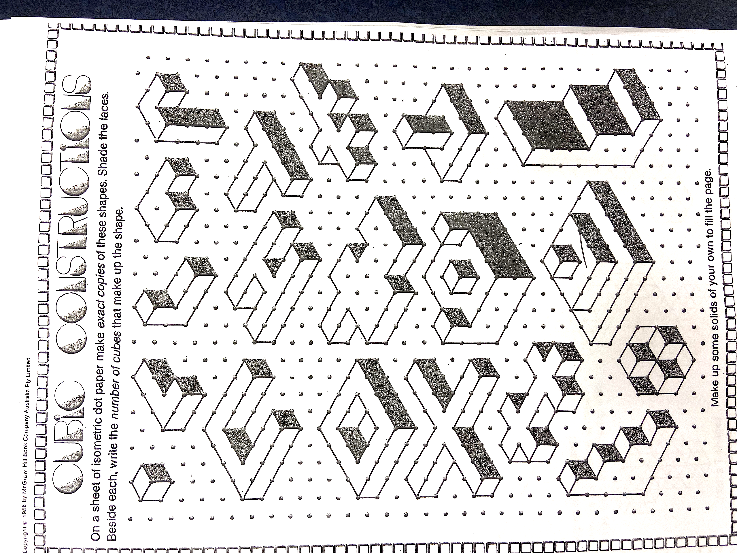
Create the following
Use your blocks to create the following shapes and then draw the top, front and right side view of each

Slide 11
Create the following
Use your blocks to create the following shapes and then draw the top, front and right side view of each

Slide 12
Exit ticket
Think → Pair → Share
What are the three ways we can represent shapes in maths?
Which two are 3D representations?
Which one uses dott paper
Which one has three different views

